Slide 1
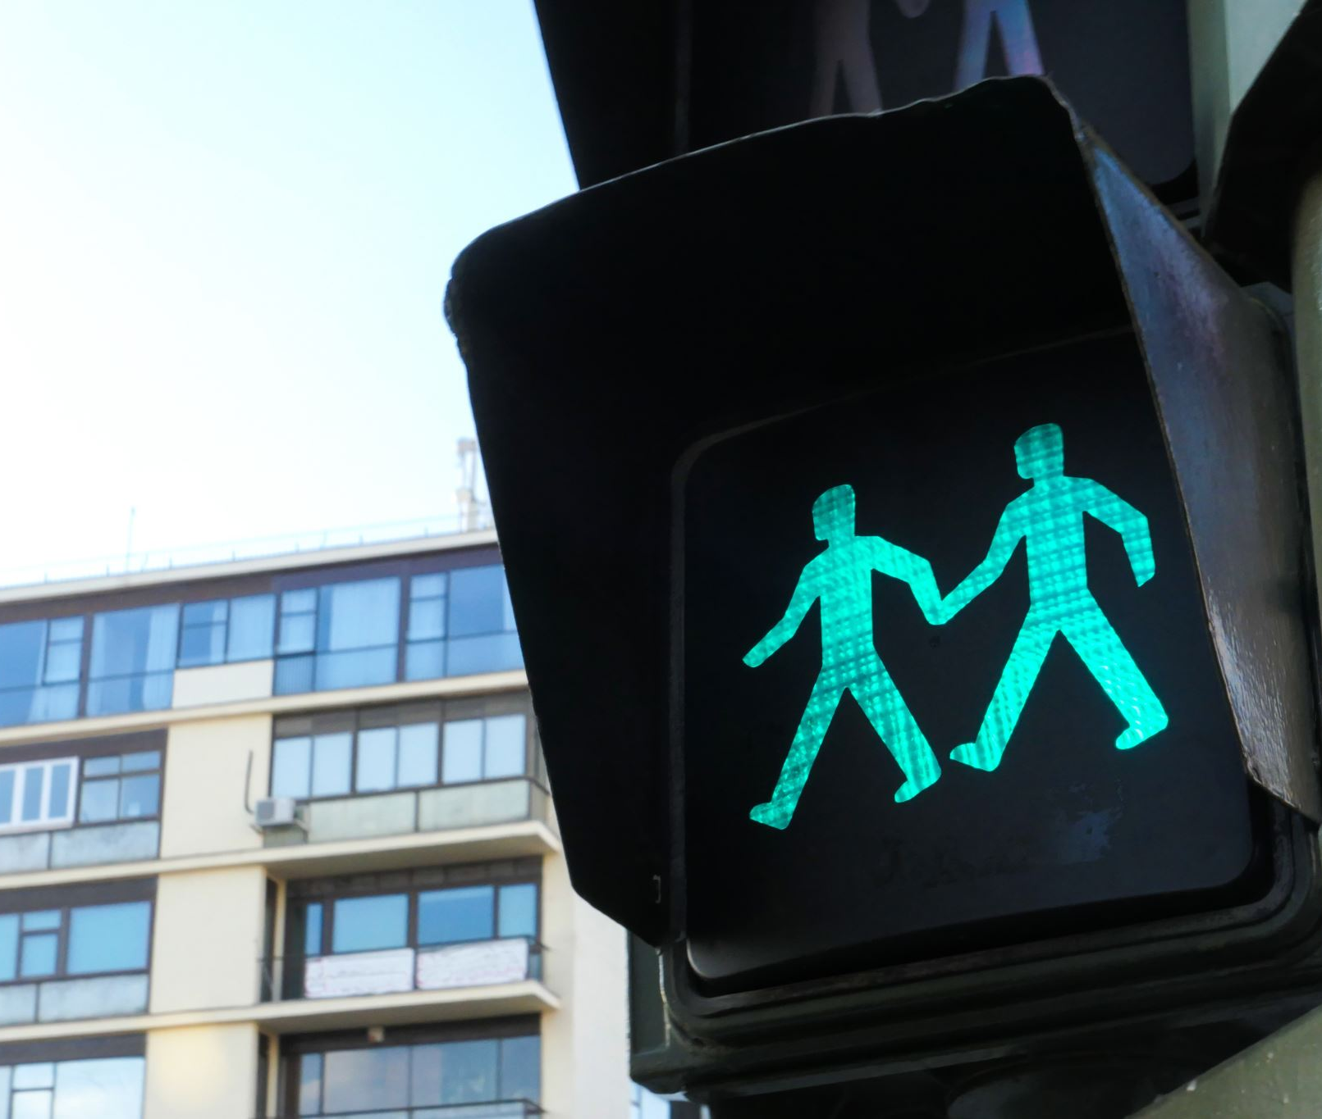
Semester project Traffic light system
Ajoke Sulaimon Adijat

Slide 2
Project goals
Model
Model traffic light system with pedestrian crossing
State
State machine Diagram
Traffic
Traffic light implementation with C++ language
Traffic
Traffic light simulation

Slide 3
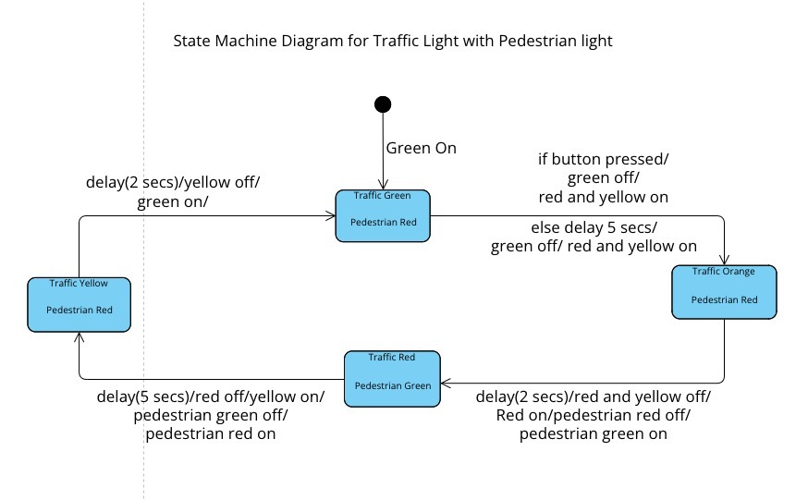
State machine model

Slide 4
Implementing code
Define all variables
Traffic flow
#define TRAFFIC_GREEN 8
#define TRAFFIC_YELLOW 9
#define TRAFFIC_RED 10
#define PED_GREEN 6
#define PED_RED 7
#define BUTTON 2
#define WHITE_BTN 11
enum traffic_light_status
{green, orange, red, yellow};
attachInterrupt(digitalPinToInterrupt(BUTTON), button_press, RISING);

Slide 5
void button_press()
{
if(status == green || status == orange)
{
digitalWrite(WHITE_BTN, HIGH);
button_pressed = true;
}
}
void traffic_red_state()
{
digitalWrite(TRAFFIC_GREEN, LOW);
digitalWrite(TRAFFIC_RED, HIGH);
digitalWrite(TRAFFIC_YELLOW, LOW);
digitalWrite(PED_GREEN, HIGH);
digitalWrite(PED_RED, LOW);
delay(10000);
digitalWrite(WHITE_BTN, LOW);
button_pressed = false;
status = orange;
}

Slide 6
void loop()
{
switch (status)
{
case green:
traffic_green_state();
break;
case yellow:
traffic_yellow_state();
break;
case red:
traffic_red_state();
break;
case orange:
traffic_orange_state();
break;
default:
break;
}
}

Slide 7
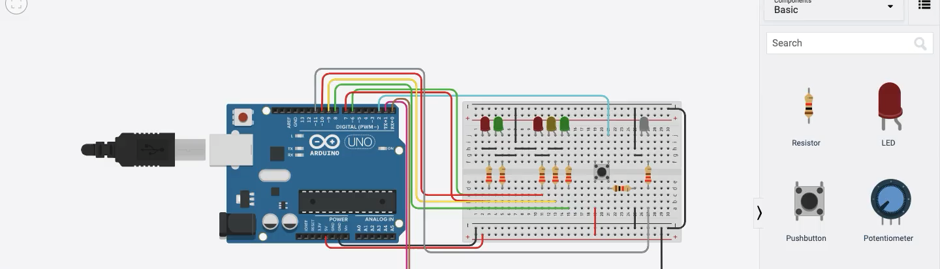
Simulation

Slide 8
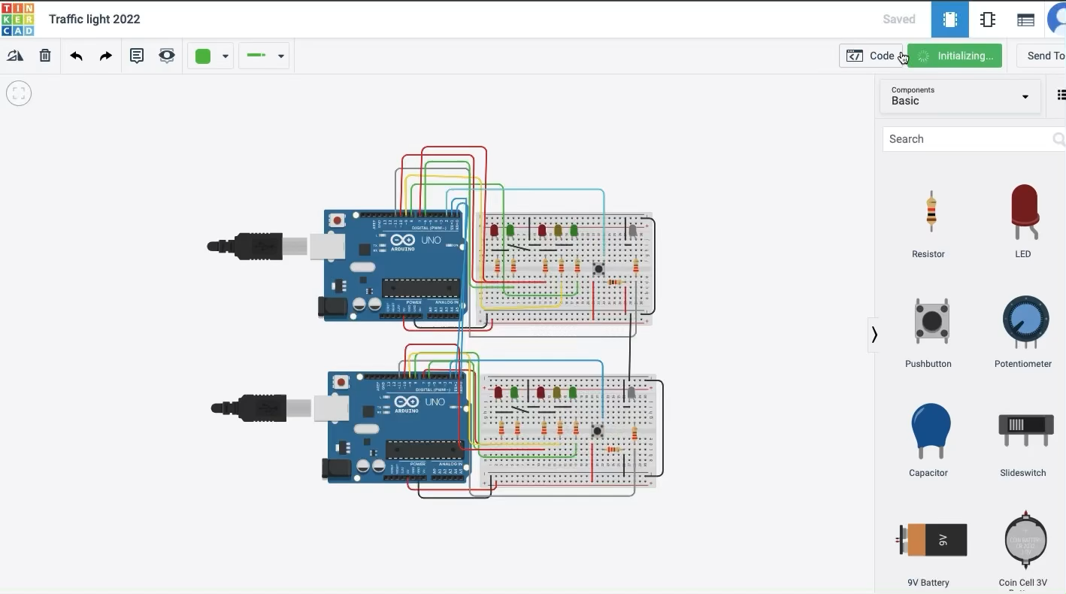

Slide 9

Thank you

